Slide 1

Finding an Edge in Sports Betting
Team E – Joseph Schoenbaum and Gabriel Kuykendall

Slide 2
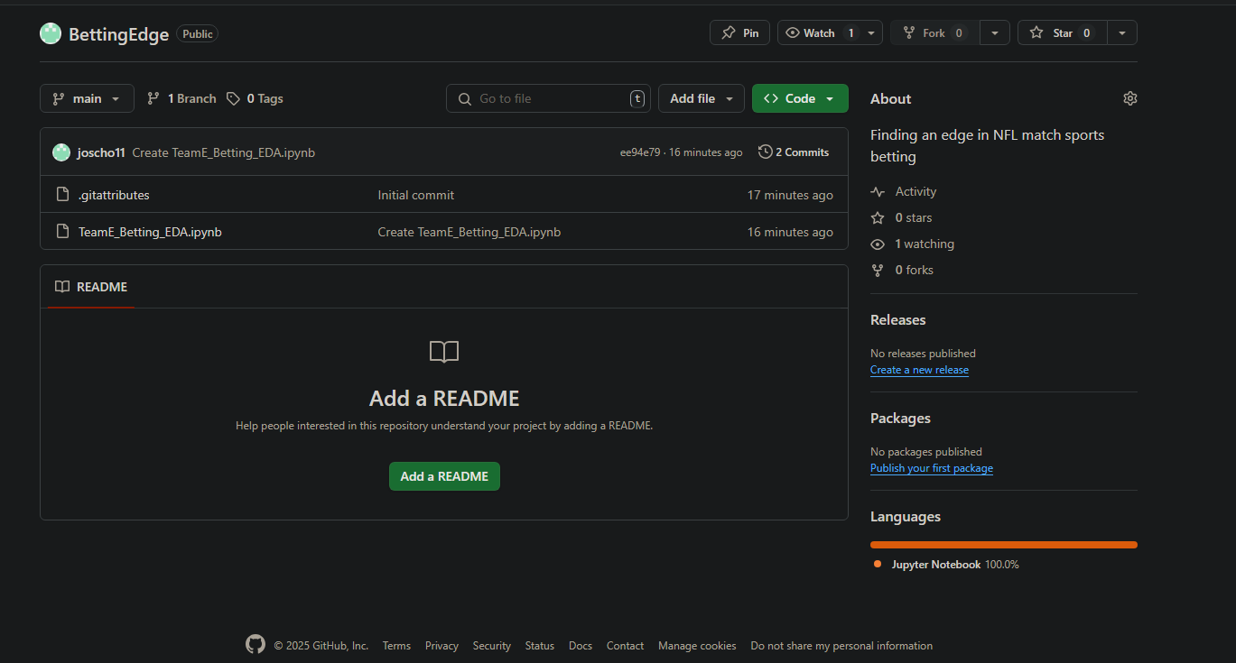
GITHUB FOR OUR PROJECT
https://github.com/joscho11/BettingEdge

Slide 3
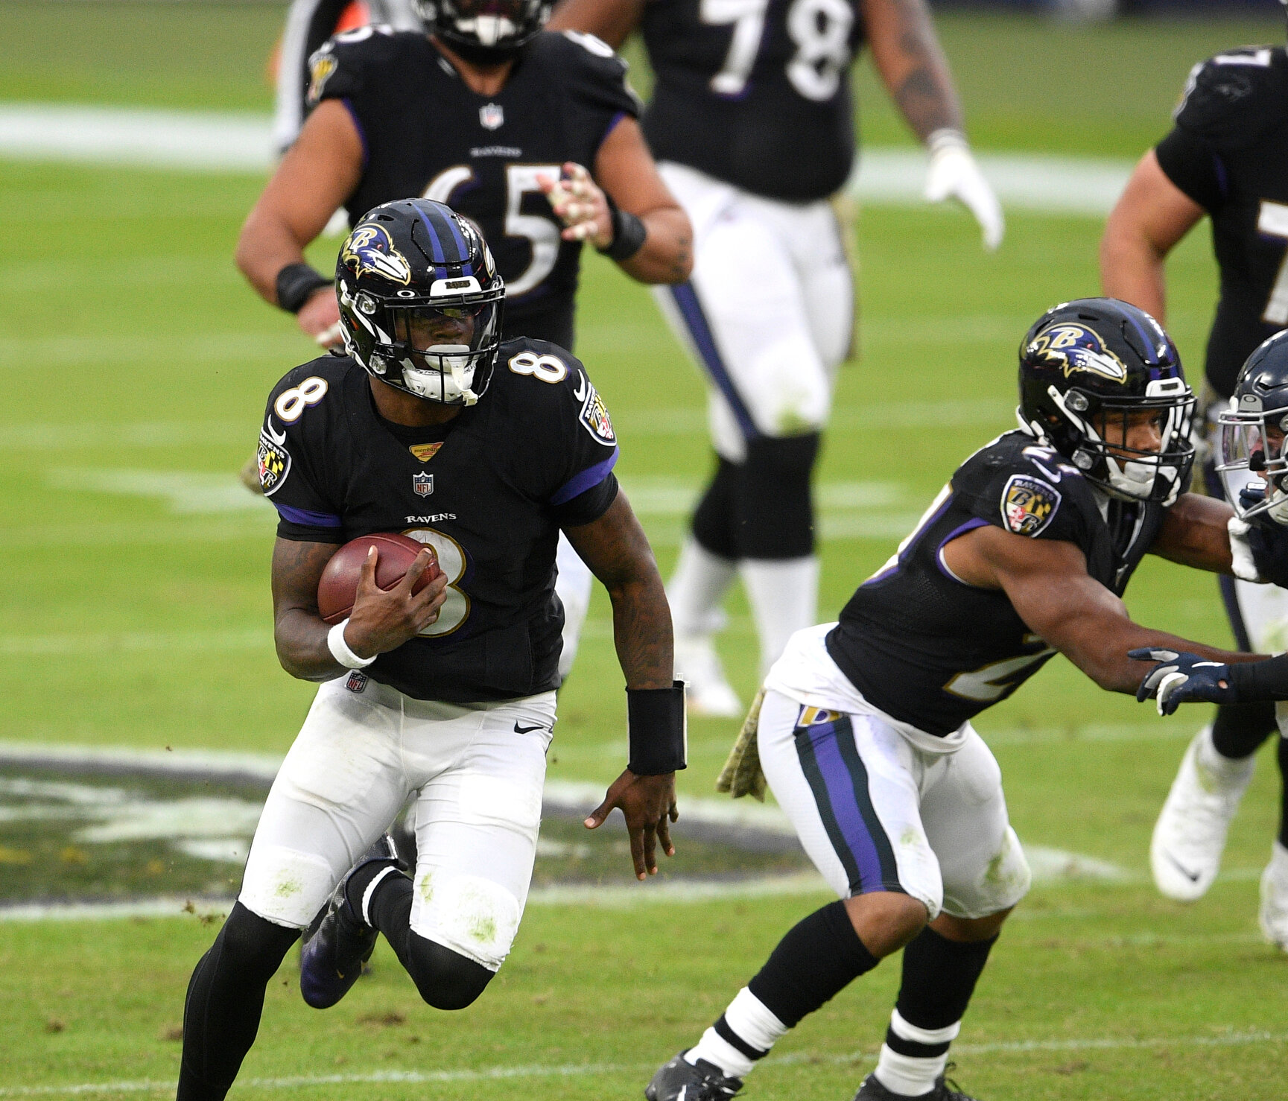
Overview
Refresher on topic
Eda
Modeling
Next Steps
References

Slide 4
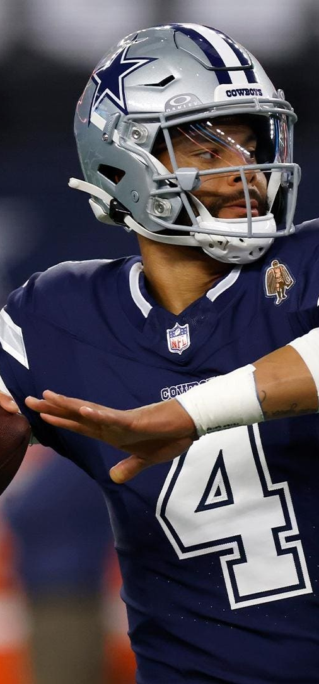
Refresher/Background
In the next slide or two, briefly refresh the audience on your project and dataset, i.e. describe the key points dataset and what kind of machine learning (ML) or data analyses (DA) is your goal on it (prediction? classification? clustering? ... ?)

Slide 5
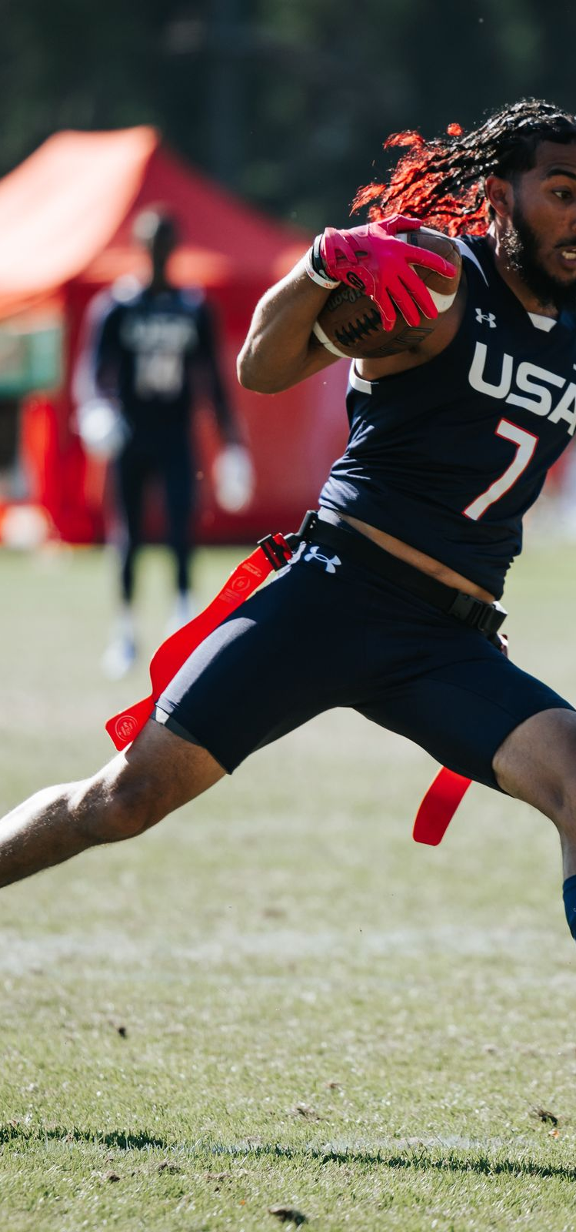
Dataset information
Provide a link to the dataset, a clear description i.e. clear info on data size, #instances/#samples, #raw attributes, #features you select/extract/use, is what you are doing a classification or prediction, if it is a classification how many categories, i.e. number of categories, what are the categories etc.). Provide all this briefly and concisely, but since it is a refresher, only point to the key items/points if you present a crowded slide.

Slide 6
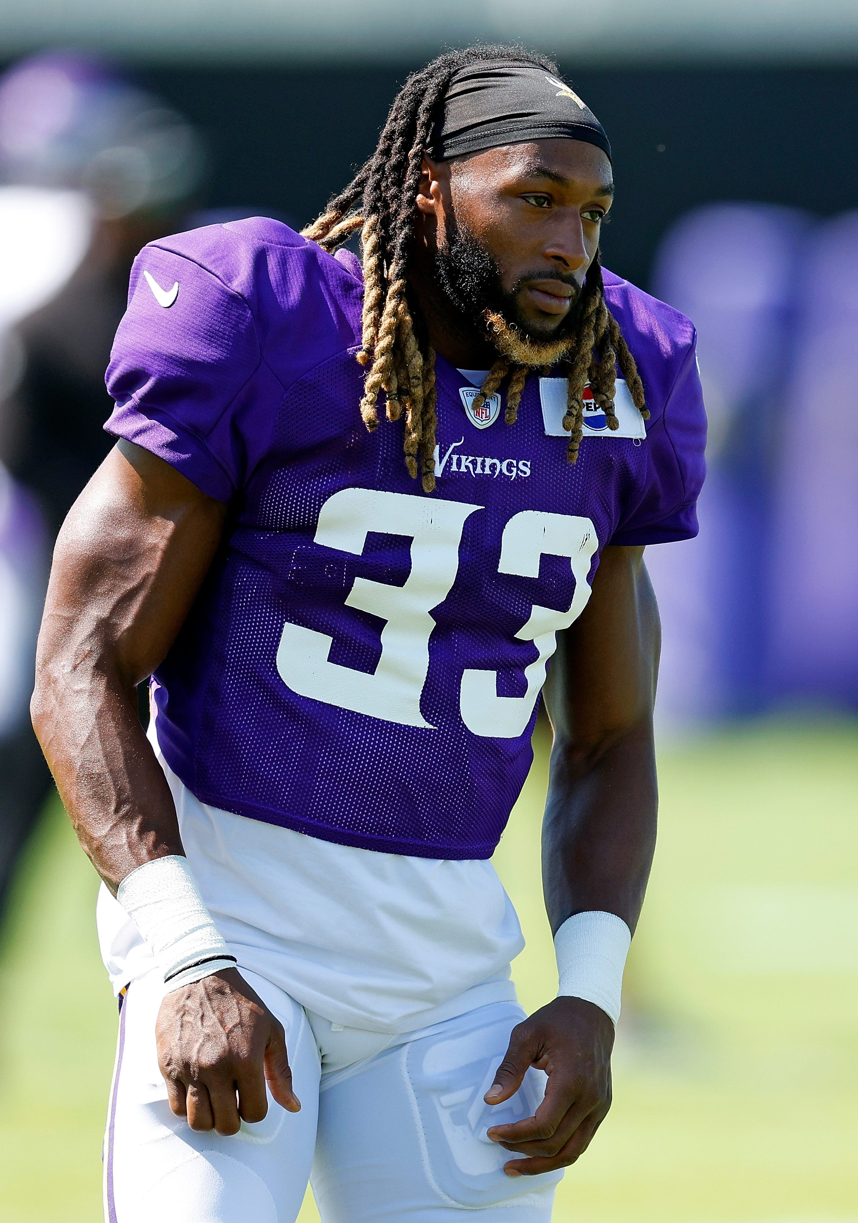
Literature Survey
In the next slide or few slides, include also a summary of what have other people have done on the dataset (what kind of feature selection/extraction & classification/regression, analysis etc), and what are your methods and models, and how yours are different.

Slide 7
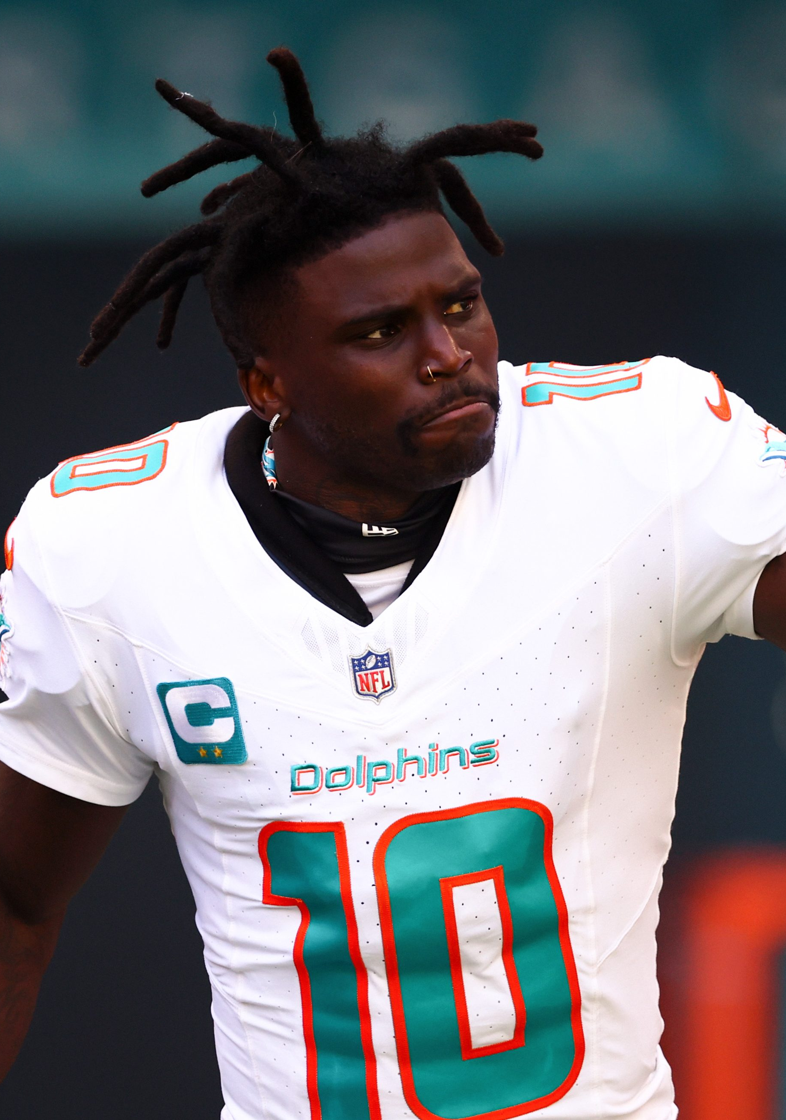
EDA Explanation
In the next slides, present your exploratory data analyses (EDA) on the dataset, and the EDA should provide a good insight into your data, present your key findings from the EDA. Bar plots, pie charts, visualizations are a must. At this point, you should have completed your data exploration stage (the dataset should be completely ready after appropriate cleansing and transformations; all the members are expected to be familiar with all the major patterns and trends in dataset). You may provide the core of your programming code that you wrote to come up with those plots/charts, but do not spend time on explaining the code as this is a short 10 minute presentation.

Slide 8
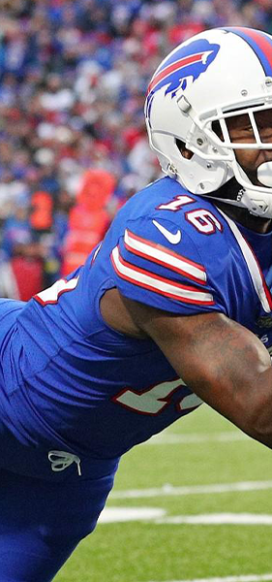
Initial Modeling – Random Forest Regressor
Based on our training we currently have 61 features
Due to encoding on categorical variables for the random forest regressor there are over a 1000 features initially
The goal of our first model is to focus in on what features are most important to our model
This can give us a better understanding of what features to focus on for further modeling/additional features in the future
Performance is relative – football is noisy
The initial evaluation metrics used are r-squared value and mean absolute error (MAE)
MAE – allows us to see how far off our prediction is without penalizing errors that are far off
Football is very noisy; outliers are bound to happen so penalizing them does not make sense
R-squared – allows us to see how well the model is capturing the variability in the data
A simple evaluation metric to see another viewpoint of our model
Current model splits the data 80/20
Current not using validation or cross-validation as this was an initial model to understand important features, in contrast to strengthening model performance

Slide 9
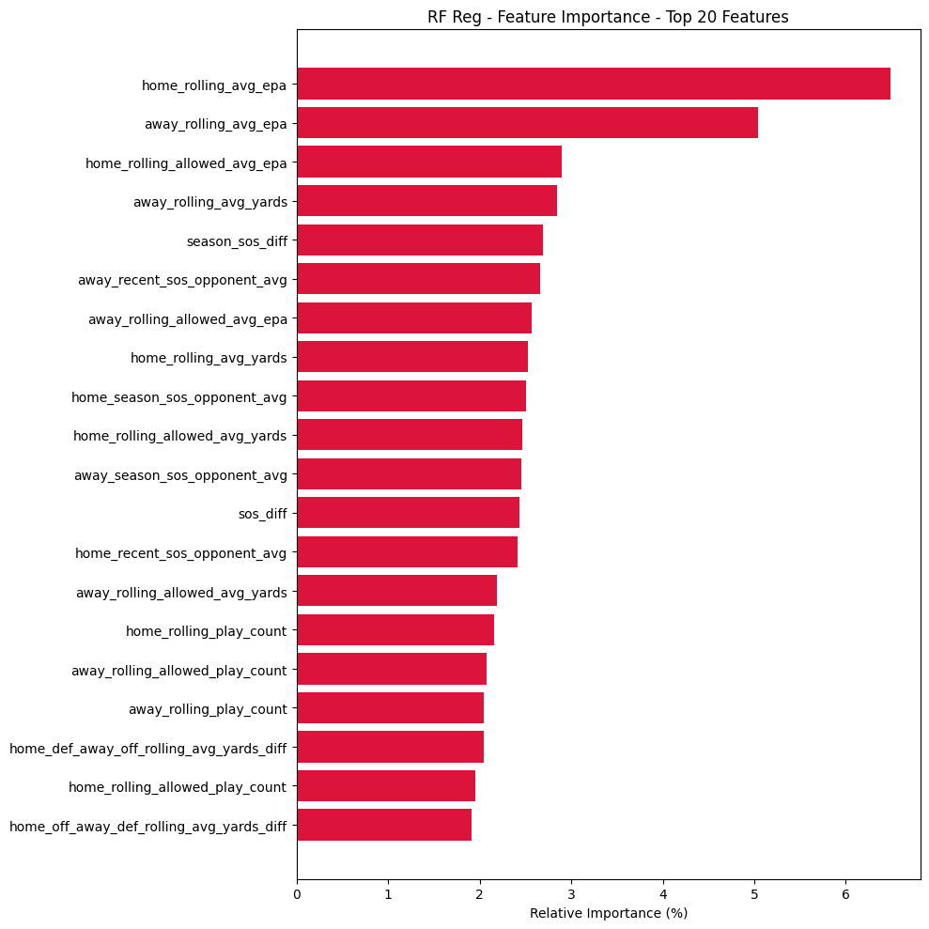
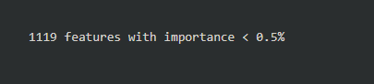
Feature Importance

Slide 10
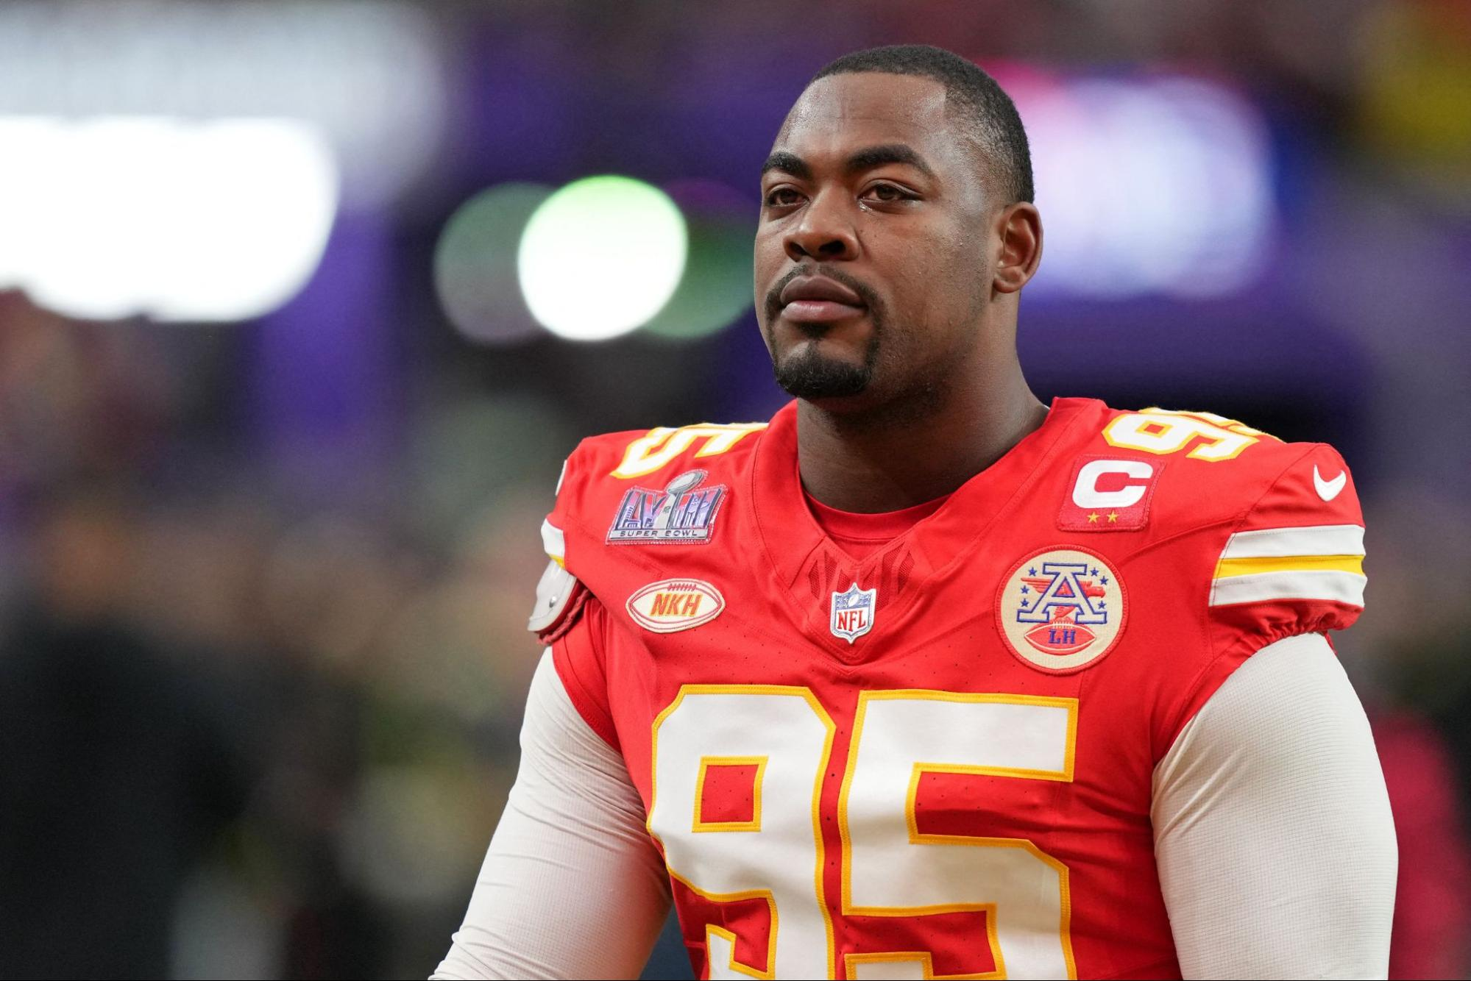
Initial Model Analysis
The MAE for our model is 10.58 which means, on average, our model predicted a game margin off by approximately 10.58 points from the real value
Typically, NFL game margins are single digit
The model is performing worse than just predicting the mean margin
NFL games are noisy
Game margins can vary heavily by just one play
An R-squared score of 9.75% means our model explains 9.75% of the variance in game margin
This is low, but not unexpected as the NFL and sports in general are very noisy
Feature Importance shows recent team performance is very important when predicting game margin
External variables such as roof, surface, stadium, etc. do not seem to have much impact
Next Iteration - Reduce redundant features

Slide 11
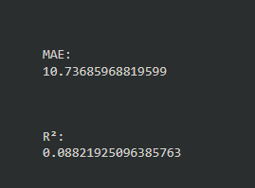
2nd Iteration – Random Forest Regressor
The goal of this iteration is to remove redundant features to get a clearer picture of the most impactful features
Removal of features will slightly reduce performance

Slide 12
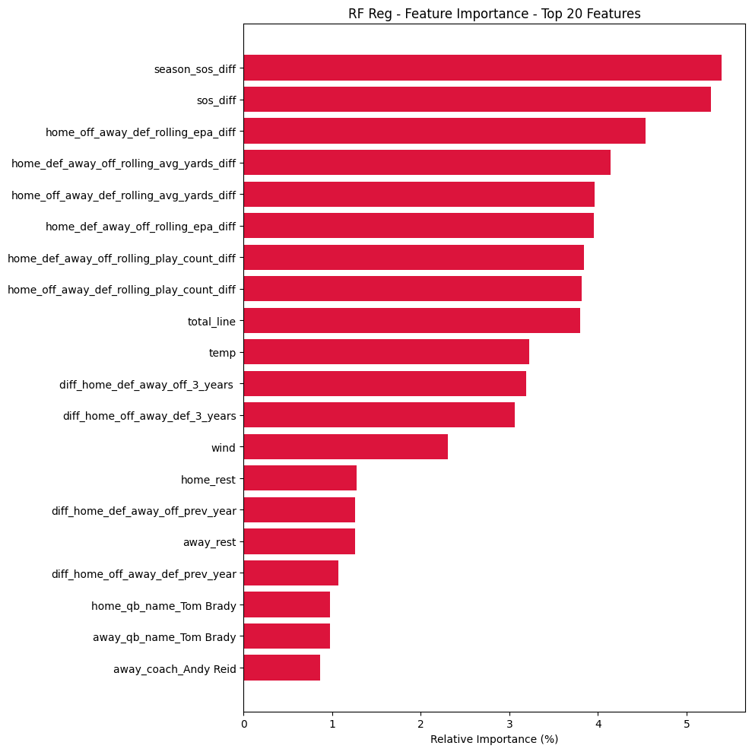

Slide 13
Next Steps
Look further into our random forest regressor to improve through modeling techniques and modifying hyperparameters
Add other features related to the most important features found from our initial model run throughs
Help to improve performance on other models

Slide 14
Brief overview of models- Gabe
at this point, you should have constructed your model (i.e. if it is a regression problem, then you should have your codes ready that are compatible with the dataset; if it is a neural network implementation, then you should complete at least one successful training, etc.). Also show model evaluation. How is your model doing in terms of performance? What performance metric(s) are you using? Why? Especially, provide the details on how you do the splitting of your data into training, validation, and testing; details of your cross-validation, folds (e.g. 40/30/30? 10-fold? leave-one-out/LOO?).)

Slide 15
References
List key references on the last slide(s) and cite those references, and/or, list a reference -in smaller fonts- at the bottom of each slide that you cite/mention the reference. So, include references and citations on the slides but you do not have to talk in detail about your references. You can talk for a few seconds if there is really a key reference that you made great use of, get inspired by, controversial, has the best results, breakthrough work, etc. anything that the audience should know about.
Main dataset - https://pypi.org/project/nfl-data-py/
Allpro dataset - ?? Nfl football reference?

Slide 16
Q&A

